Slide 1
How to obtain COUNTER usage reports and cost per use for the electronic collection “Ebook Central Perpetual, DDA and Subscription Titles”
Yoel Kortick – Senior Librarian

Slide 2

Contents
  Background
  Introduction
  Prerequisites
  Creating the usage and cost per use report in the e-inventory subject area - option 1
  Creating the usage and cost per use report in the e-inventory subject area - option 2
  Creating the usage report in the usage data subject area - option 1
  Creating the usage report in the usage data subject area - option 2

Slide 3

Background

Slide 4
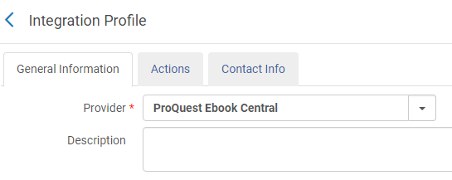
Background
This is the integration profile of type “Upload Electronic Holdings” for “ProQuest Ebook Central”
See here for further details.

Slide 5
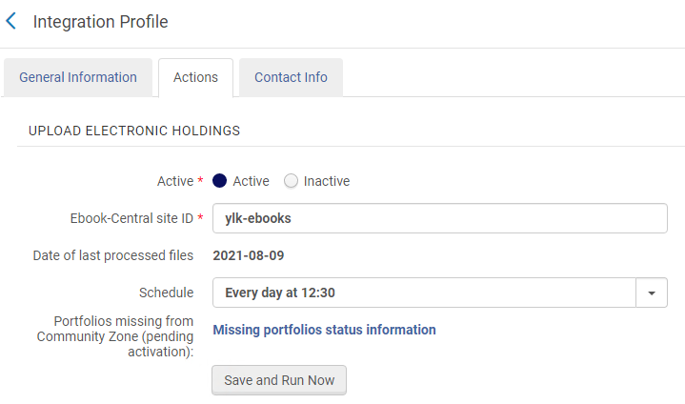
Background
In the setup below it will run every day at 12:30

Slide 6
Background
The electronic holdings get updated for Community Zone electronic collection “Ebook Central Perpetual, DDA and Subscription Titles”.
See Activating Ebook Central Perpetual, DDA and Subscription Titles.

Slide 7
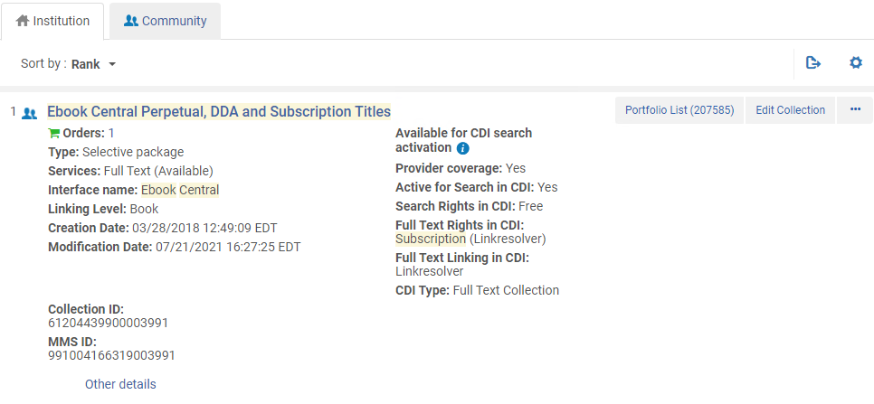
Background
Here is the electronic collection:
In the institution
Activated from the Community Zone

Slide 8

Introduction

Slide 9
Introduction
In this presentation we will show how to obtain COUNTER usage reports for the electronic collection “Ebook Central Perpetual, DDA and Subscription Titles”.
We will make
  Two reports in the E-Inventory subject area
  Two reports in the Usage Data subject area
The reports in the E-Inventory subject area will look at usage within the framework of cost per use.
The reports in the Usage Data subject area will look at detailed in depth usage.

Slide 10
Introduction
The E-Inventory subject area includes the COUNTER usage measures necessary for cost per use
The Usage Data subject area includes all usage measures.
Thus, for example, the Usage Data subject area includes all TR_B1 (Book Requests) and TR_B3 (Book Usage by Access Type) measures.
The E-Inventory subject area includes the TR_B1 measure ('TR_B1 - Unique Title Requests’ ) for calculating cost per use.
TR_B3 is not relevant for cost per use and thus it is not included in the E-Inventory subject area.

Slide 11
Introduction
We will describe here how to create an Alma Analytics report to show usage and cost per use for the electronic collection “Ebook Central Perpetual, DDA and Subscription Titles”.
At a later stage Ex Libris will provide a “built-in” ready to use reports for this under the ‘Alma’ folder.
In any case it is recommended to learn how to make such a report as described here
  So that you will understand what it does
  So that you can customize it as specifically needed in your institution

Slide 12
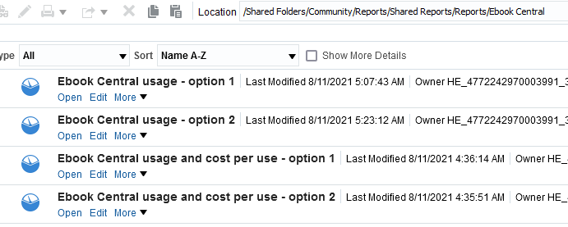
Introduction
The four reports described here may be found in the community folder ‘/shared/Community/Reports/Shared Reports/Reports/Ebook Central’.
If you use these reports you should first copy them to your institution folder.

Slide 13
Introduction
Explaining the meaning behind each measure that we will use in the Usage Data subject area is beyond the scope of this presentation.
For more information about these measures see “4.3 Title Reports” at The COUNTER Code of Practice for Release 5 on the official COUNTER website, as well as other sources.

Slide 14


Prerequisites

Slide 15
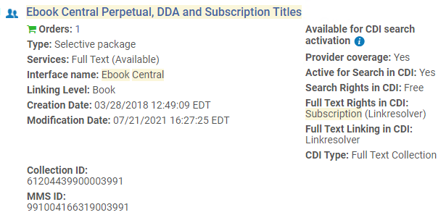
Prerequisites
In order to obtain usage data you must have already loaded COUNTER reports for the resources in the electronic collection “Ebook Central Perpetual, DDA and Subscription Titles”
In order to obtain cost per use data you must also have a POL connected to the electronic collection

Slide 16
Prerequisites
The COUNTER reports will typically begin with one of the following strings:
  Sushi_Ebook Central_tr_b1
  Sushi_Ebook Central_tr_b3
  Sushi_ProQuest Ebook Central_tr_b1
  Sushi_ProQuest Ebook Central_tr_b3
As the file names suggest, the measures for the resources in Ebook Central are
  tr_b1 (Book Requests)
  tr_b3 (Book Usage by Access Type)

Slide 17
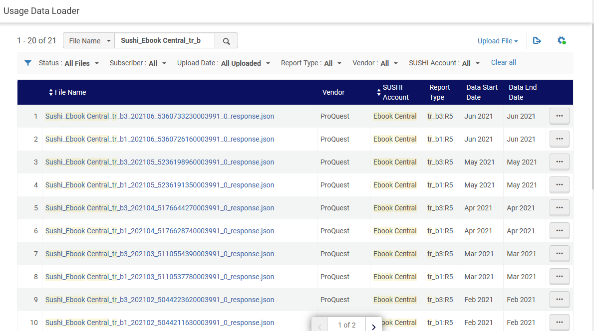
Prerequisites
For example (as seen via 'Acquisitions > Import > Load Usage Data):
TR_B1 and TR_B3 reports which have been loaded to Alma

Slide 18

Creating the usage and cost per use report in the e-inventory subject area – option 1

Slide 19
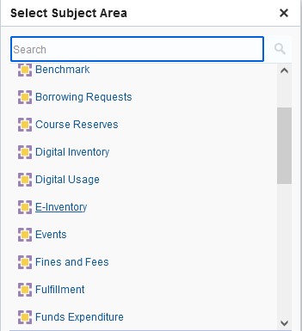
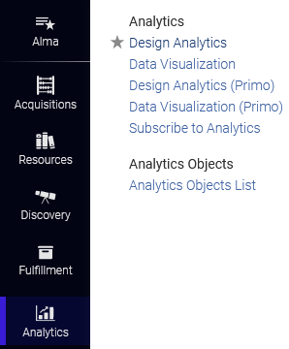
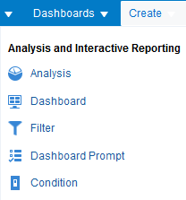
Creating the usage and cost per use report in the e-inventory subject area - option 1
Access Alma Analytics and create a report in the E-Inventory subject area.

Slide 20
Creating the usage and cost per use report in the e-inventory subject area - option 1
Include the following fields (the value before the period is the folder, the value after the period is the field). This is a recommendation. You can include other fields (or remove some of these) depending on your specific needs.
  "Bibliographic Details"."Title"
  "Cost Usage POL"."PO Line Reference"
  "Electronic Collection"."Electronic Collection Interface Name"
  "Electronic Collection"."Electronic Collection Public Name"
  "Portfolio"."Portfolio Id"
  "Cost Usage Measures"."Cost Per Use"
  "Cost Usage Measures"."Cost"
  "Cost Usage Measures"."Usage TR_B1“
  "Fiscal Period"."Fiscal Period Start End"

Slide 21
Creating the usage and cost per use report in the e-inventory subject area - option 1
Filter as follows:
  "Electronic Collection"."Electronic Collection Public Name" = 'Ebook Central Perpetual, DDA and Subscription Titles'
It is recommended to filter by one specific complete fiscal year.
  "Fiscal Period"."Fiscal Period Filter" = 'Previous Fiscal Year'

Slide 22
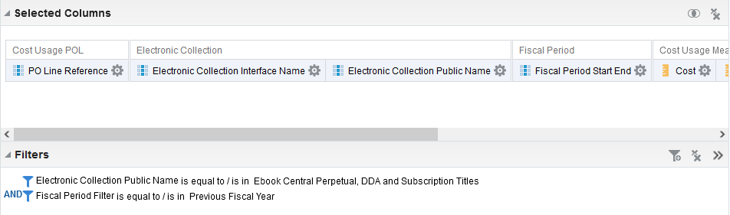
Creating the usage and cost per use report in the e-inventory subject area - option 1
Here is the criteria tab (partial screenshot)

Slide 23
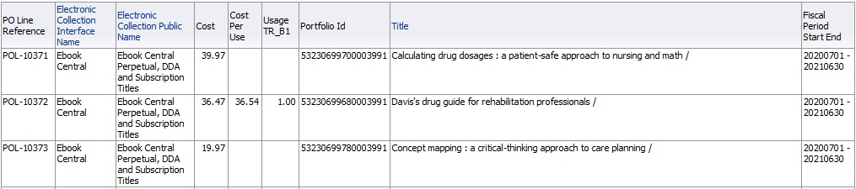
Creating the usage and cost per use report in the e-inventory subject area - option 1
Here are the results (partial screenshot)

Slide 24

Creating the usage and cost per use report in the e-inventory subject area – option 2

Slide 25
Creating the usage and cost per use report in the e-inventory subject area - option 2
The previous example shows each portfolio in the collection.
If you want the entire collection without a detailed analysis of each portfolio then remove the following three fields from the display:
  "Portfolio"."Portfolio Id"
  "Bibliographic Details"."Title"
  "Cost Usage POL"."PO Line Reference"

Slide 26
Creating the usage and cost per use report in the e-inventory subject area - option 2
Now we have one line for the entire collection.
31,463.80 / 19,978.18 = 1.57

Slide 27

Creating the usage report in the usage data subject area - option 1

Slide 28
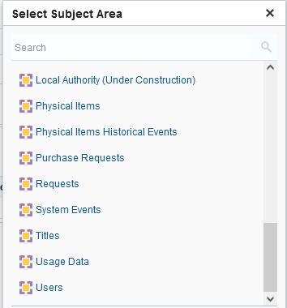
Creating the usage report in the usage data subject area - option 1
Access Alma Analytics and create a report in the Usage Data subject area.

Slide 29
Creating the usage report in the usage data subject area - option 1
Include the following fields (the value before the period is the folder, the value after the period is the field). This is a recommendation. You can include other fields (or remove some of these) depending on your specific needs.
  "Platform"."Platform"
  "Title Identifier"."Display Title"
  "Usage Date"."Usage Date Fiscal Year Key"
  "Usage Data Details - Release 5"."TR_B1 - Total Item Requests"
  "Usage Data Details - Release 5"."TR_B1 - Unique Title Requests"
  "Usage Data Details - Release 5"."TR_B3 - Total Item Investigations"
  "Usage Data Details - Release 5"."TR_B3 - Total Item Requests"
  "Usage Data Details - Release 5"."TR_B3 - Unique Item Investigations"
  "Usage Data Details - Release 5"."TR_B3 - Unique Item Requests"
  "Usage Data Details - Release 5"."TR_B3 - Unique Title Investigations"
  "Usage Data Details - Release 5"."TR_B3 - Unique Title Requests"

Slide 30
Creating the usage report in the usage data subject area - option 1
Filter as follows:
  "Load File"."Load File Name" contains any 'Ebook%Central_tr_b’
  A filter like this will include reports with begin in either of the following two ways:
    Sushi_Ebook Central_tr_b
    Sushi_ProQuest Ebook Central_tr_b
It is recommended to filter by one specific complete fiscal year.
  "Usage Date"."Usage Date Filter" = 'Previous Fiscal Year'

Slide 31
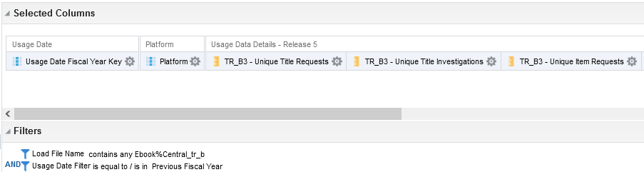
Creating the usage report in the usage data subject area - option 1
Here is the criteria tab (partial screenshot)

Slide 32
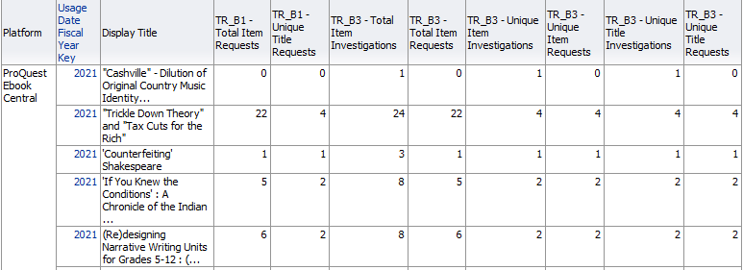
Creating the usage report in the usage data subject area - option 1
Here is the results tab (partial screenshot)

Slide 33

Creating the usage report in the usage data subject area - option 2

Slide 34
Creating the usage report in the usage data subject area - option 2
The previous example shows each title.
If you want a summary of all of the titles together without a detailed analysis of each title then remove the following field from the display:
  "Title Identifier"."Display Title"

Slide 35

Creating the usage report in the usage data subject area - option 2
Now we have one line summarizing all titles.

Slide 36
xxx@exlibrisgroup.com

